Slide 1
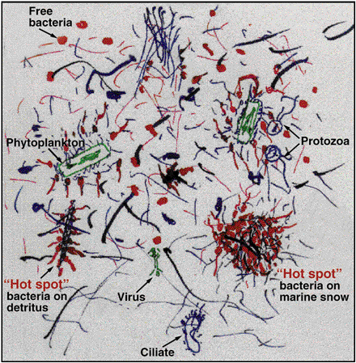

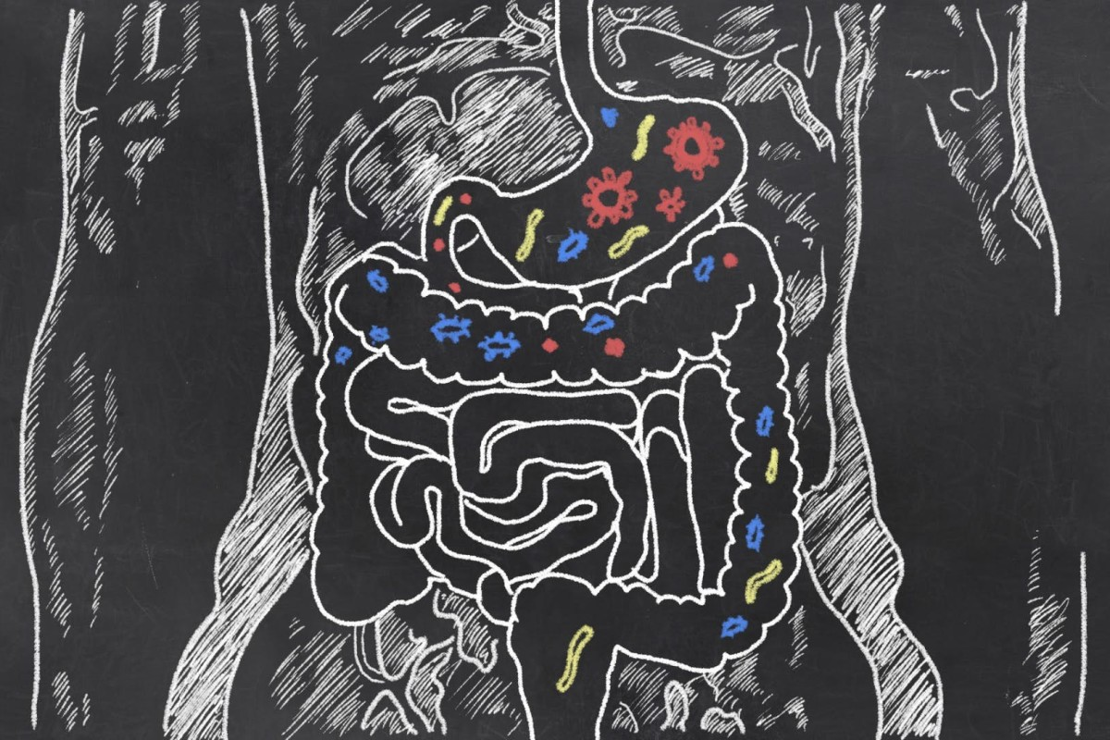
Metagenomics Lesson 3

Slide 2
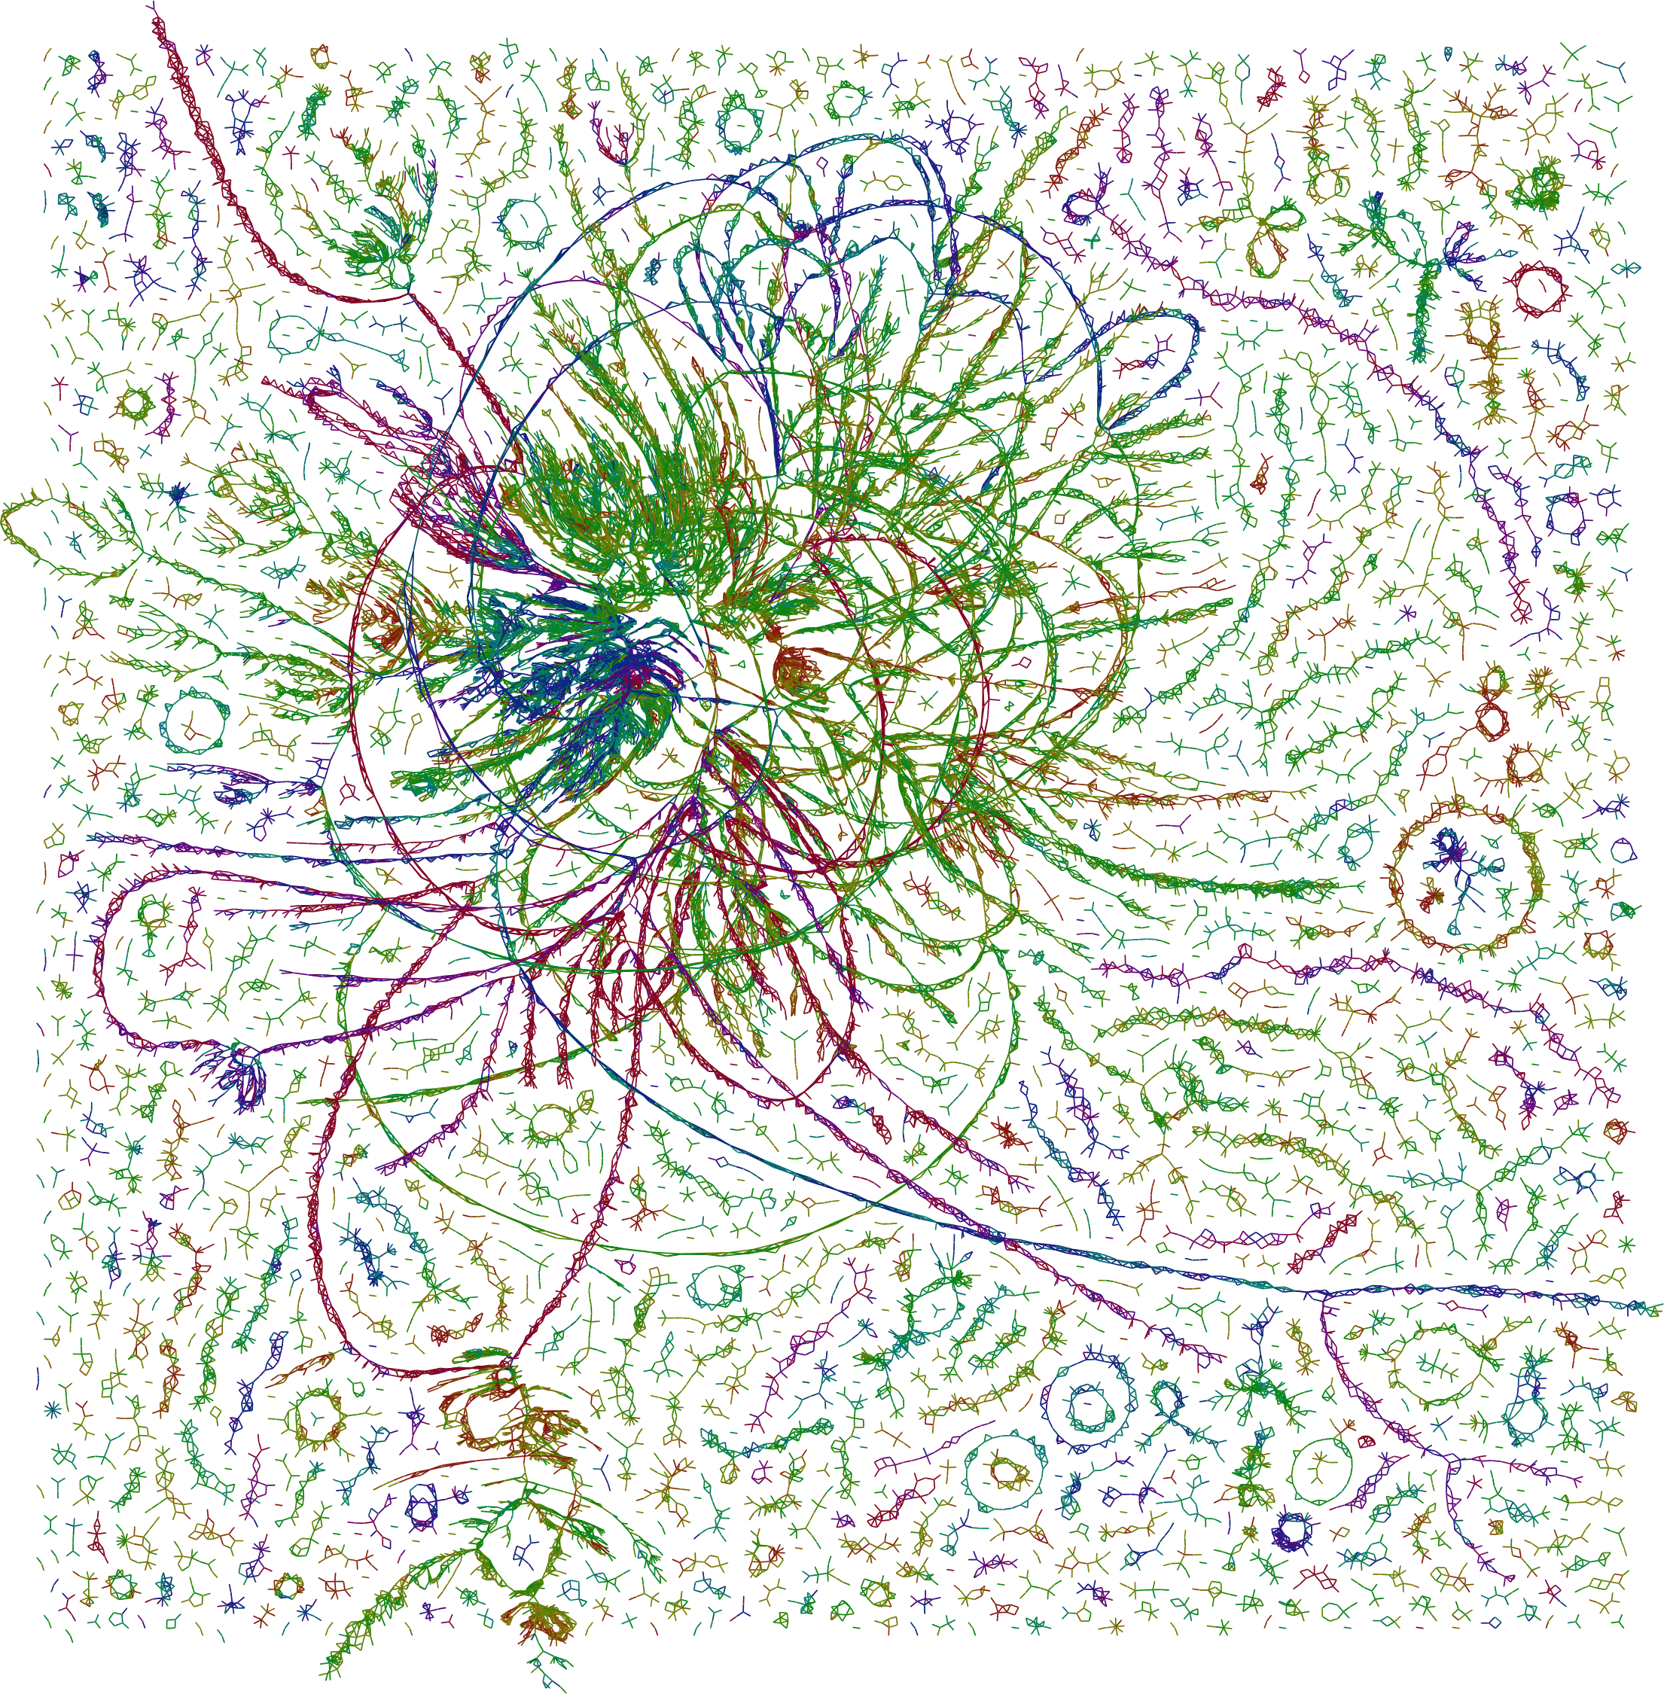
Metagenomics Lesson 3
Taxonomic Classification using MinHash
MinHash algorithm
Demo: Classification using sourmash
Demo: Quality trimming using bbduk
Demo: Classification using sendsketch

Slide 3
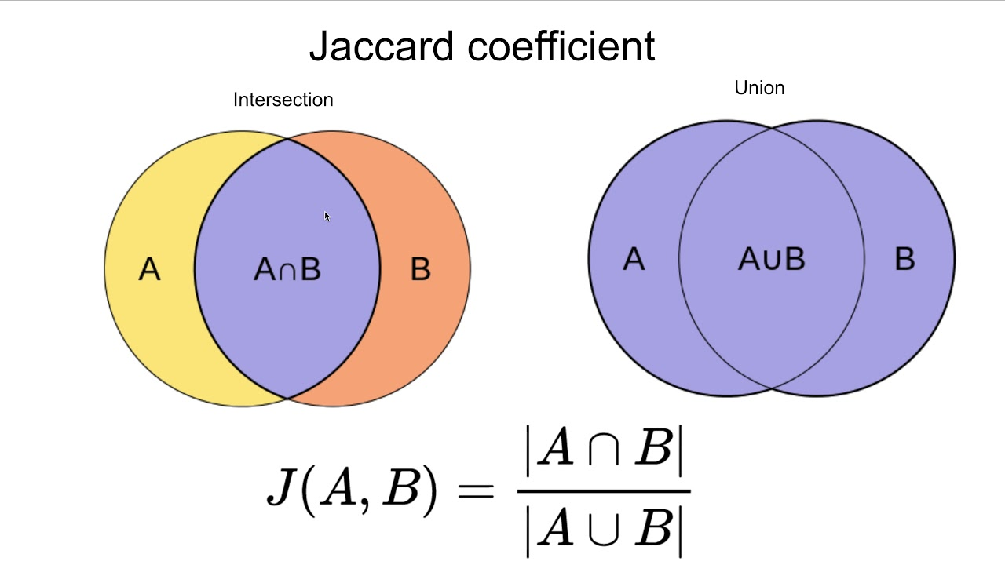
Set Similarity: Jaccard index
Let’s say we have two genomes that we’d like to compare based on their gene content.
In this case a set is composed of a collection of genes in each genome.
The Jaccard Similarity is a measure of set similarity given by the intersection of the sets divided by their union.
That is, we count the number of shared genes (encoded in both genomes), and divide that by the total number of unique genes that both genomes collectively encode.
If Genome A has 3000 genes
And Genome B has 3000 genes
And they share 1000 genes
Then J(A,B) = 1000/(2000 + 2000 + 1000) = 1/5

Slide 4
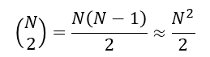
Genomes as sets: k-mers
There are currently 335,736 genomes in the NCBI Genomes database.
To compare all-vs-all would require about 56 billion comparisons.
This would take a long time if the full set of k-mers was used for each comparison.
Instead of using “genes” as sets, we could use “k-mers” instead.
In principle, we could break every genome into its component k-mers (say k=21), and end up with about 3 million k-mers each (for a bacterium)
That ends up being computationally expensive when you have many sets to compare:

Slide 5
MinHash Sketches
A hash function maps an input range to a fixed output range.
Example of a bad hash function:
Take a string of DNA bases: ACATACTCGATCAGCTGAC
Substitute 0 for A/T and 1 for C/G 0100010110010110101
Take the first 5 digits and decimal-ize 1000
This will lead to collisions where many different sequences will end up with the same hash. A good hash function has high compressibility, high randomization, low collision rate, and high speed.
One way to simplify this massive computational job is to approximate the Jaccard Index instead of calculating it exactly.
The MinHash algorithm does this. For DNA sequences:
Extract all k-mers from a sequence
Use a hash function to reproducibly convert k-mers into numbers that are randomly distributed over some range.
Choose the numerically lowest s hashes (min hashes) as the bottom sketch
Compare bottom sketches against each other using the Jaccard index

Slide 6
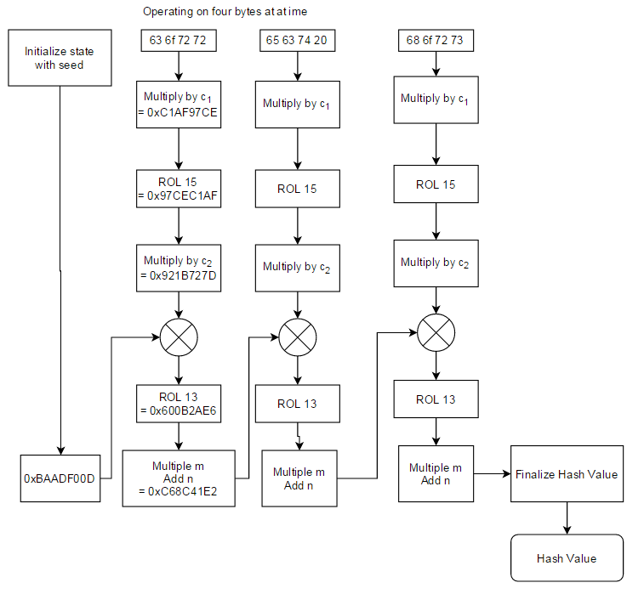
Hashing functions
MurmurHash3 function
The hashing function used in most MinHash implementations is MurmurHash3. Identical sequences hashed using the same function and k-mer size will produce identical hashes. Here are the bottom-10 sketches for two strains of Shewanella baltica. Q: What is their Jaccard Index?
575255017582
935685935937
2925290528259
14491025556507
23965553957178
24424404261705
26390034908046
41098902080483
43898691665130
47367865367011
2925290528259
7397951382043
21567977839038
23965553957178
26390034908046
43898691665130
46272541519390
46736359986916
46822418898135
47180432856748

Slide 7
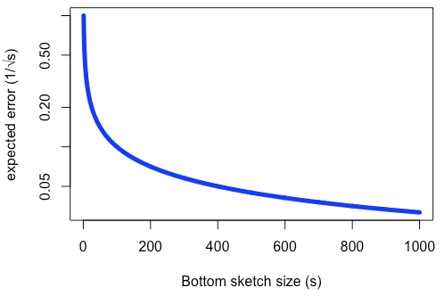
Hashing functions
Q: Why not just take the lexicographically smallest s k-mers?
A: Because that’s not a random selection, you could have biases due to GC content, unusual genes, etc. Some implementations use a blacklist or other techniques to avoid artifacts.
Q: Why not randomly select s k-mers from each set and sort them lexicographically?
A: Because it’s unlikely two large sets will overlap with a small s unless they are highly similar. Using the bottom sketch ensures that an overlap will be found if it exists.
Q: How many signatures are needed to get a good approximation? A: Using MinHash, the expected error rate is e=1/sqrt(s), such that e=0.05 at s=400

Slide 8
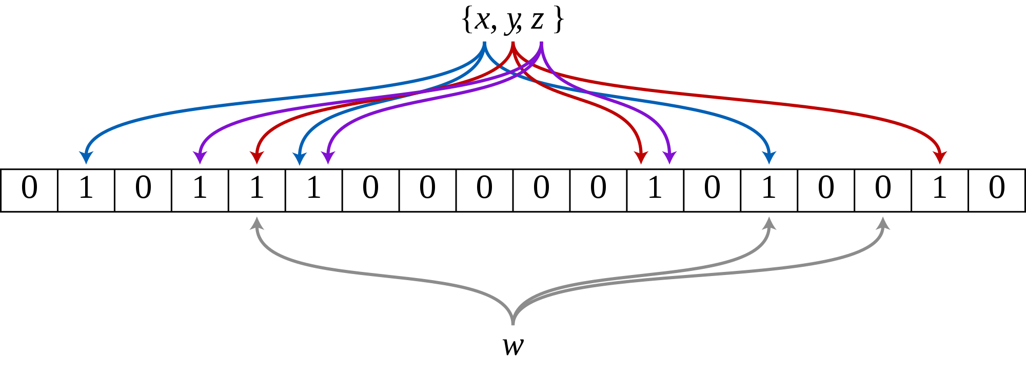
Bloom filters
A common way to speed up k-mer computations in bioinformatics is to use a (Burton Howard) Bloom filter to test whether an element is a part of a set. It trades a large memory footprint for speed on tasks like rejecting singletons or error-containing k-mers.
A Bloom filter is described by 2 parameters:
m = length of filter (e.g. 2³¹ bits) initialized to all 0s
n (<<m) = number of hash functions that each produce a hash in the range of the filter (e.g. 1 to 2³¹).
Procedure:
To insert an element: calculate all n hashes and insert them by flipping the corresponding bits to 1
To test whether an element is part of a set: calculate all n hashes and check the bits.
If all bits are set, then “maybe”
If at least 1 bit is unset, then “definitely not”
False positives are possible. False negatives are not possible. The desired false positive rate can be tuned by changing m and n.

Slide 9
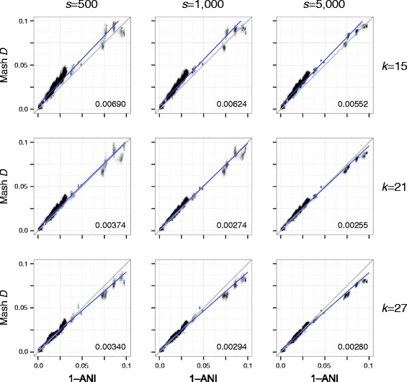
MinHash compared to ANI
Average Nucleotide Identity (ANI) is a method to compare the similarity between core genomes. MinHash does a good job approximating ANI.
“Scatterplots illustrating the relationship between ANI and Mash distance for a collection of Escherichia genomes. Each plot column shows a different sketch size s and each plot row a different k-mer size k. Gray lines show the model relationship D = 1–ANI and numbers in the bottom right of each plot give the root-mean-square error versus this perfect model. Blue lines show linear regression models. Increasing the sketch size improves the accuracy of the Mash distance, especially for more divergent sequences. However, there is a limit on how well the Mash distance can approximate ANI, especially for more divergent genomes (e.g. ANI considers only the core genome)”
Ondov et al. (2016)

Slide 10
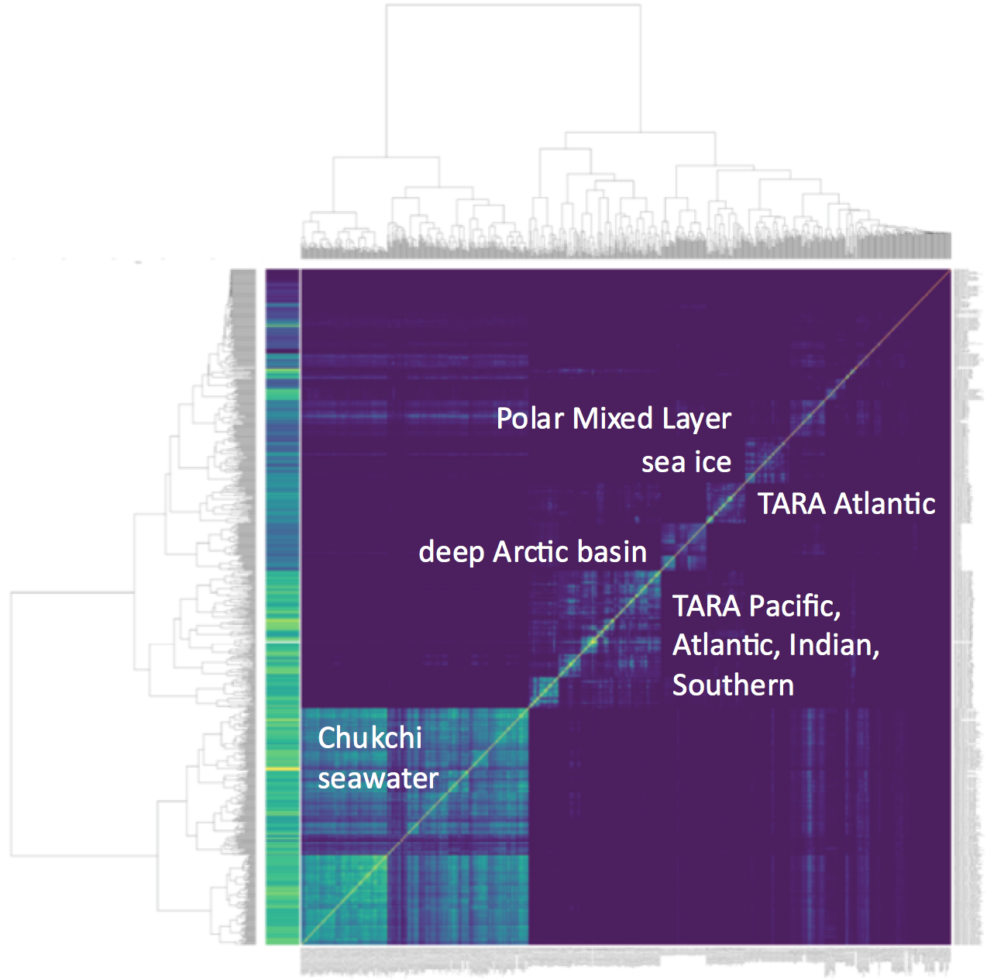
MinHash metagenome comparisons
MinHash can be used to quickly compare metagenomes for related content, including containment of a particular genome in the metagenome.
The figure on the right is a MinHash comparison of about 1000 ocean metagenomes, colored by pairwise Jaccard Index.
Sourmash has the following databases available for download to use in metagenome classification:
60k RefSeq microbial genomes
100k GenBank microbial genomes
87k GenBank microbial genomes LCA

Slide 11
MinHash implementations
Mash [https://github.com/marbl/mash]
can use a Bloom filter to exclude singletons and other method for min k-mer count
Implemented online at PATRIC Similar Genome Finder
Sourmash [https://github.com/dib-lab/sourmash]
can use a Bloom filter with counting for min k-mer count
can use a ‘scaled’ (proportional) s rather than static
can generate figures
LCA taxonomic classification
bbsketch [https://sourceforge.net/projects/bbmap]
can use min k-mer count
can use optional scaled s
can use blacklist
LCA taxonomic classification
Finch [https://github.com/onecodex/finch-rs]
Can use a Bloom filter for min k-mer count

Slide 12
Resources
McCormick, C. (2015, June 12). MinHash Tutorial with Python Code. Retrieved from http://www.mccormickml.com
https://genomebiology.biomedcentral.com/track/pdf/10.1186/s13059-016-0997-x
https://en.wikipedia.org/wiki/Bloom_filters_in_bioinformatics
https://en.wikipedia.org/wiki/MinHash
https://f1000research.com/articles/8-1006
https://www.quora.com/What-is-the-simplest-example-of-a-hash-function
https://www.slideshare.net/gakhov/probabilistic-data-structures-part-1-membership

Slide 13
Demo #3.1: sourmash, bbduk, sendsketch
Launch binder: https://mybinder.org/v2/gh/biovcnet/metagenomics-binder-qc/master?urlpath=lab
Click ‘Terminal’
In the file browser on the left, navigate to topic-metagenomics/Lesson-3/ and open Demo3.1_sourmash_bbduk_sendsketch.sh

Slide 14
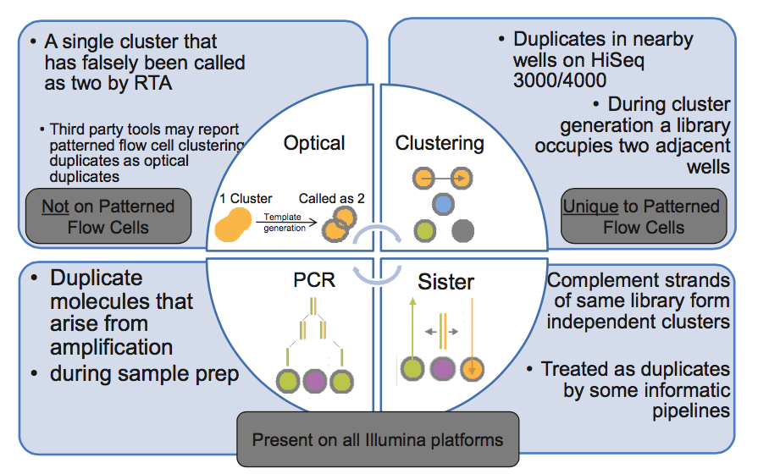
Read duplicates in Illumina data
https://core-genomics.blogspot.com/2016/05/increased-read-duplication-on-patterned.html

